Slide 1
BINGO
GROUP 13
Preetham Reddy Annavaram
Pavan Kumar Reddy Bhumireddy
Hemanth Kumar Gulivindala
Saikiran Reddy Kondreddy
Afnan Ali Mohammed
Ramu Valivarthi
Sai Keerthi Vanga

Slide 2
SOFTWARE VISION
FOR the students and public WHO wants to save time and money, THE BINGO project is a web application operating across the internet, THAT provides Instant and scheduled delivery Options within one day, more payment options (like COD) than the existing applications, GPS tracking, Easy Returns, Social media Integration, Voluntary services, bidding system and push Notifications. UNLIKE other delivery websites (such as Walmart, Amazon), OUR website helps the people in saving money and time by delivering the products at affordable prices in a day without any subscription.

Slide 3
USER STORIES
➢ Booking an order
As a customer, I want an easy online grocery shopping experience to search for and manage items in my cart and Wishlist, so that I can have flexible delivery options and a variety of secure payment methods to ensure a convenient and satisfying shopping process.
➢ Online Tracking
As a customer, I want to track my order online for real-time updates from packaging to delivery, so that I can get a worry-free experience, allowing me to plan my day efficiently.
➢ Social media Handles
As a user, I want to follow grocery companies on social media for the latest trends and deals, so that I prefer online grocery shopping for its time-saving convenience and the ability to plan purchases around promotions.
➢ Reviews and Ratings
As a registered user, I want to be able to provide reviews and ratings for products or services, so that I can share my feedback and experiences with others and help them make informed decisions about their purchases.
➢ Payment Methods
As a User, I want to be able to add multiple payment methods to my account, such as credit cards, debit cards, digital wallets, and cash on delivery (COD), so that I can choose the most convenient option for each order.

Slide 4
➢ Order History​
As a registered user of the web application, I want to be able to view my order history and understand the return policy for products I've purchased, so that I can easily initiate a return or check the status of a return request.​
➢ Push Notifications​
As a user, I want push notifications for messages, updates, and announcements, so that I stay informed and a notification history is crucial, as is security alerts, and order delivery updates for an enhanced experience.​
➢ Authorization and Authentication​
As a user, I want to have access to features and data based on my permissions, ensuring a safe and secure experience, so that I can expect administrators to assign roles (admin, user, editor) with specific permissions, resulting in personalized dashboards. This enhances my experience by providing access to only what's relevant and necessary for my role and responsibilities.​
As a user, I want a secure user authentication and security system that ensures safe logins. This system should require unique usernames and strong passwords for registered users, so that it should also allow new users to create accounts with distinct credentials and provide options for password resets via email or SMS. To enhance security, I expect the system to include two-factor authentication (2FA).

Slide 5
TECHNOLOGIES
Database
MS SQL
Back-End
C# and Dotnet
Front-End
HTML and CSS

Slide 6
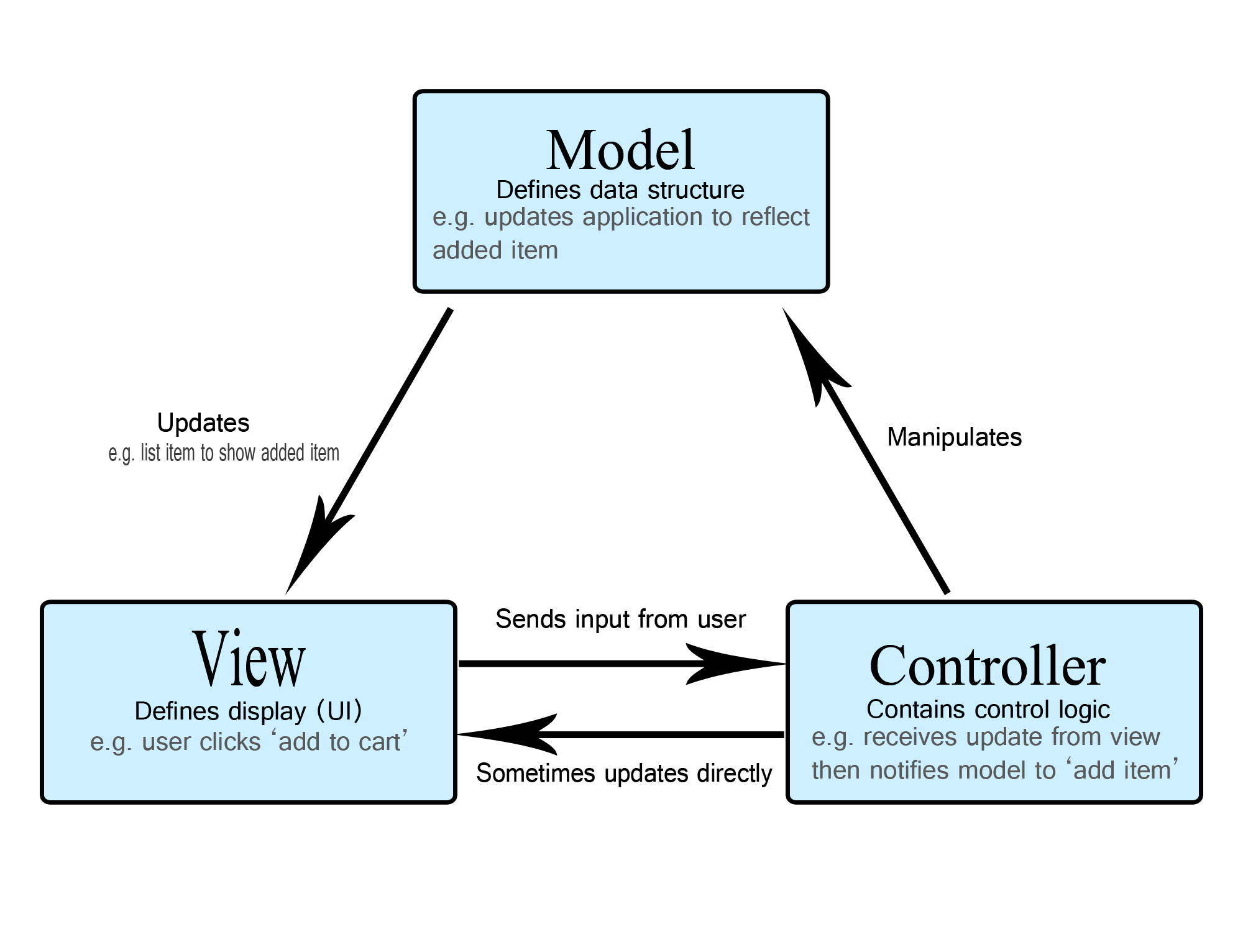
MVC MODEL

Slide 7
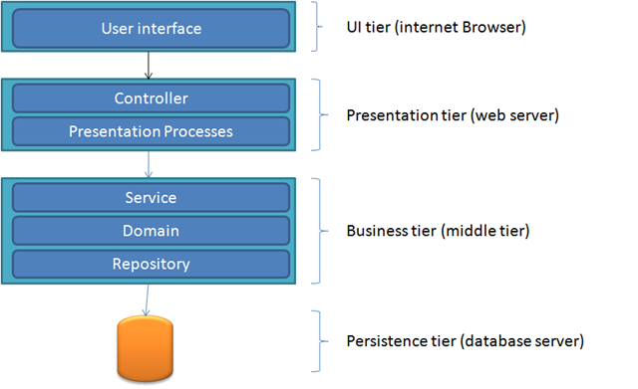

Slide 8
PROJECT ARCHITECTURE
User
Presentation Layer (User, Product, Home)
Application Layer (controllers, Services, Interfaces)
Data Layer(Entities, Models, DbOperations)
Database

Slide 9
1. Single Codebase:
The entire application, including the user interface, business logic, and data access layers, is developed and managed within a single codebase.
2. Presentation Layer:
Contains the user interface elements developed using ASP.NET CORE MVC and uses HTML, CSS, JavaScript, and client-side frameworks for user interface application.
3. Application Layer:
It consists of business logic, including user management, product catalog, order processing, etc.
Written in .NET using C# and other relevant languages for implementing business rules and functionalities.
4. Data Layer:
Manages data storage, retrieval, and manipulation.
Uses MS SQL Server as the database system, interacting with Entity Framework for data access using LINQ(Language Integrated Query).

Slide 10
FUTURE ARCHITECTURE PLAN
DevOps and Deployment:
We would like to deploy our project with the help of Azure
In a monolithic setup, the deployment process involves deploying the entire application as a single unit.
CI/CD pipelines, if used, manage the build, test, and deployment processes for the entire monolith.

Slide 11
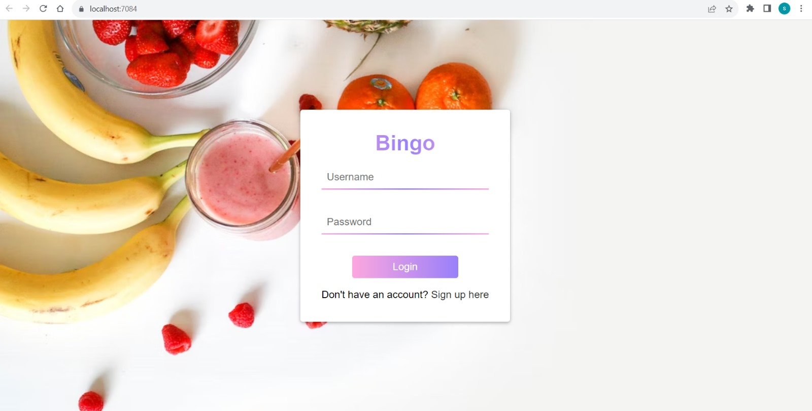
DEMO
Login Page

Slide 12
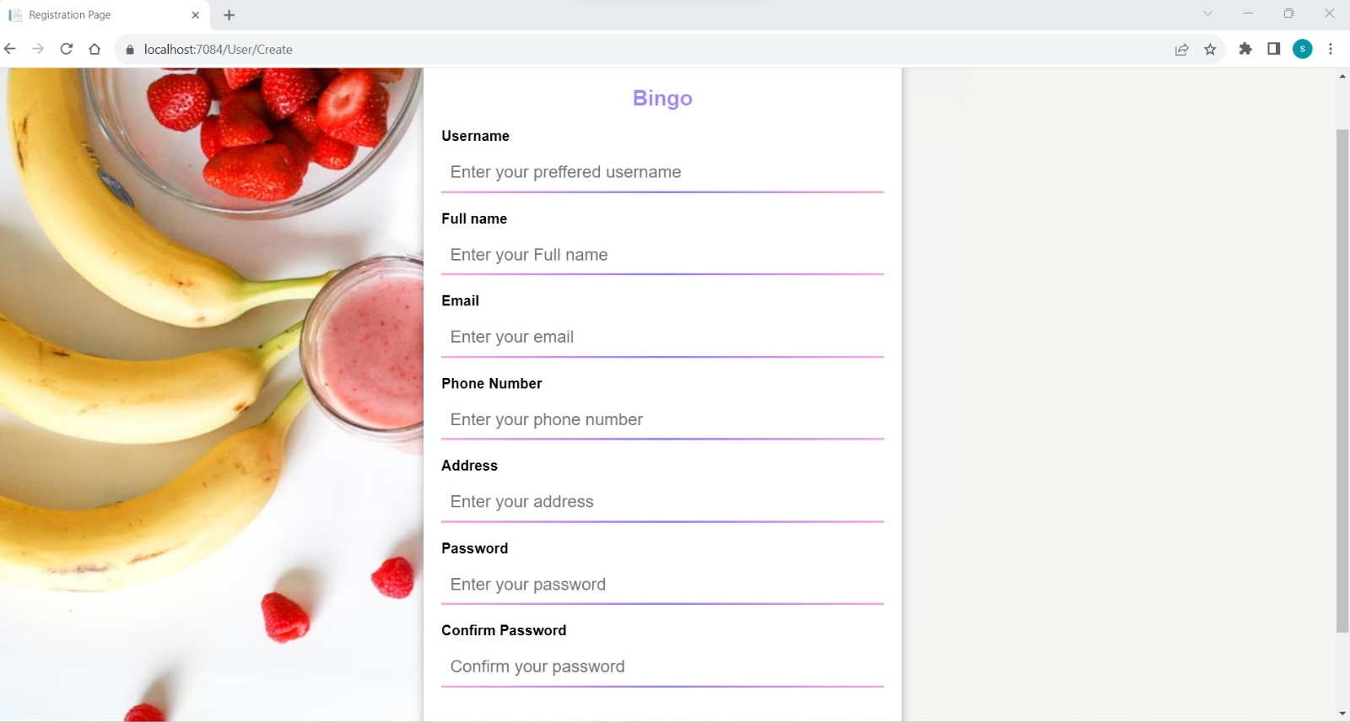
Registration page

Slide 13
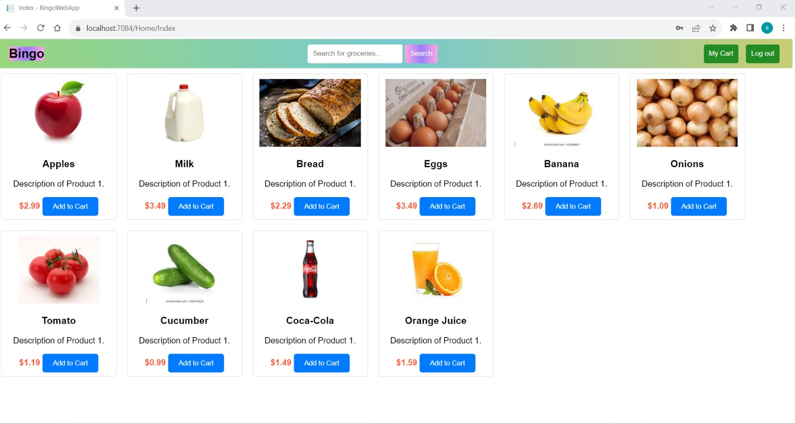
Dashboard

Slide 14
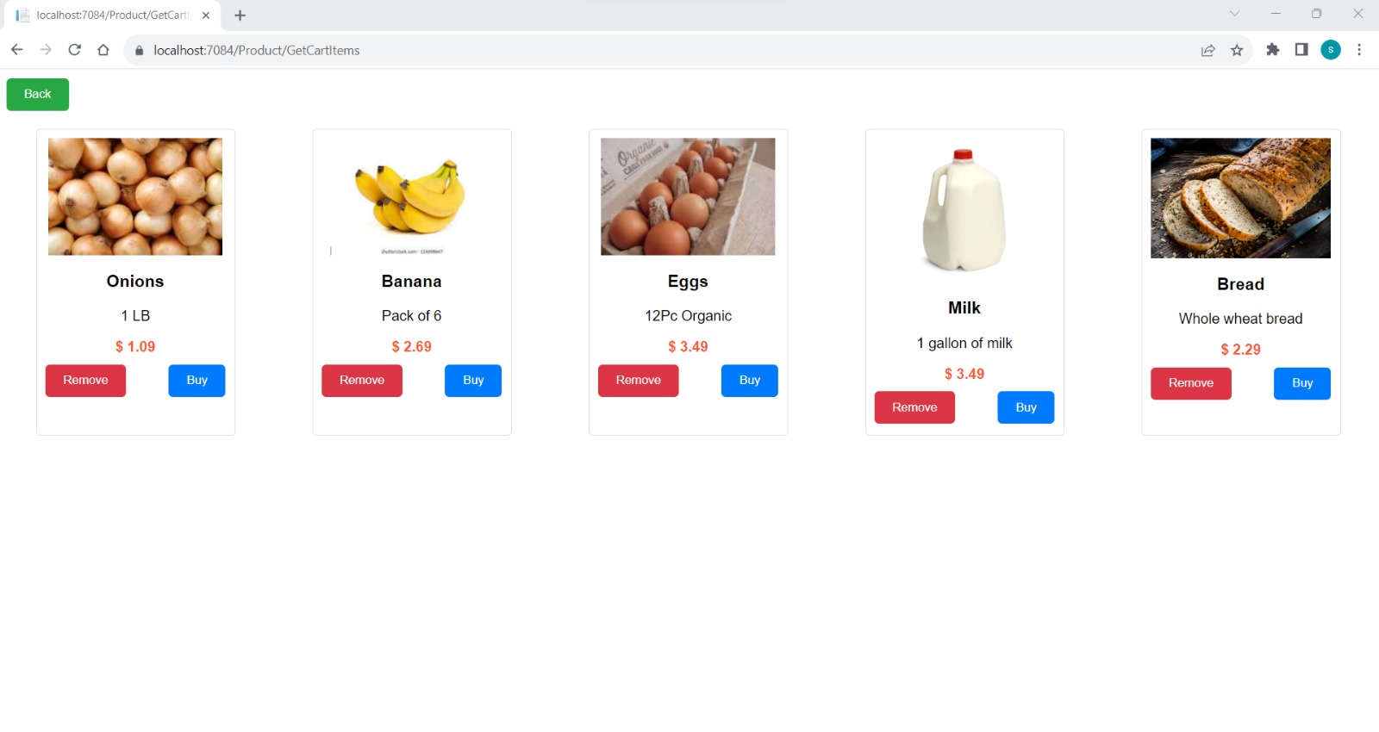
Cart

Slide 15
THANK YOU

